Slide 1
User Interfaces for
Embedded Systems
Presentation 5:
Prototyping

Slide 2
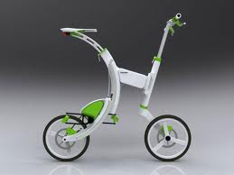
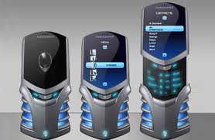
Prototype
Prototype derives from the Greek word prototypon meaning "primitive form", and prototypos, "original, primitive", from protos, meaning "first" and typos, "impression".

Slide 3
Motivation
Prototypes allows us to try out different designs
Prototypes allows us evaluate usability early and often
Prototypes are cheaper than end-products
Prototyping is well-suited to human nature
Iterative research & development approach proven useful

Slide 4
“The Waterfall Model”
Origins: Civil Engineering
Bridge building
Need to secure delivery
Specify everything!
Does not always work well
- In a software development perspective
- Promotes building the product right – not the right product
Requirements
specification
Architectural
design
Detailed
design
Coding and
unit testing
Integration
and testing
Operation and
maintenance
Notes:
Originally reported by Royce – as how development is being performed at that time. Not an example to follow! Left fig: small projects. Top right: flawed approach. Bottom Fig: better approach
http://www.cs.umd.edu/class/spring2003/cmsc838p/Process/waterfall.pdf

Slide 5
Design Fallbacks
- Design fallbacks are one solution
- Problems with interactive systems
- Very expensive with long fallbacks
- Users do not understand Use Cases
or Class Diagrams and similar
lots of feedback!
Requirements
specification
Architectural
design
Detailed
design
Coding and
unit testing
Integration
and testing
Operation and
maintenance

Slide 6
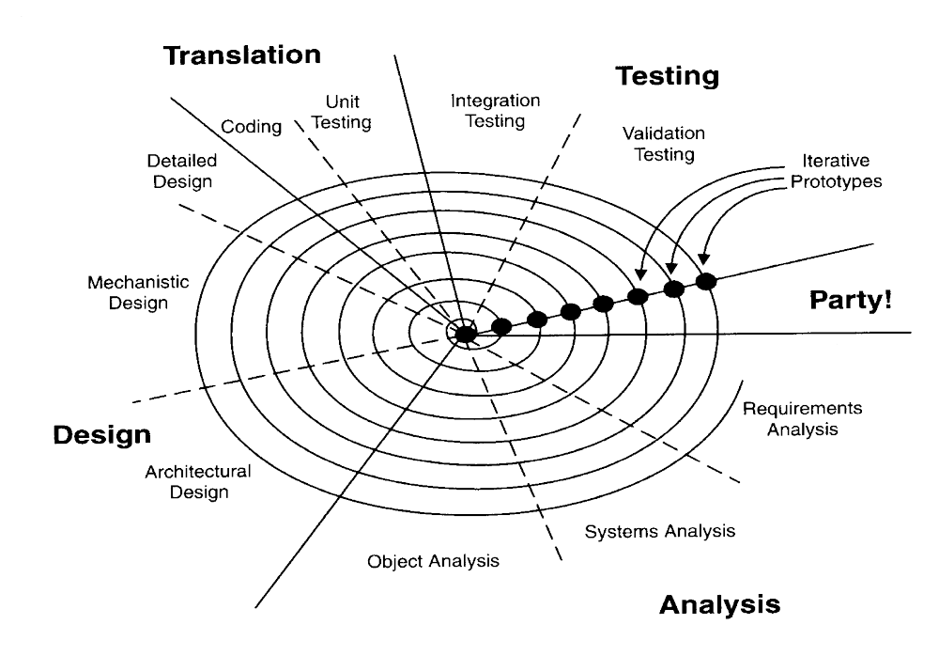
Iterative Rapid
Development Proces
Iterations helps significantly
on usability problems (Bohm 1988)
But if not verified – then useless

Slide 7
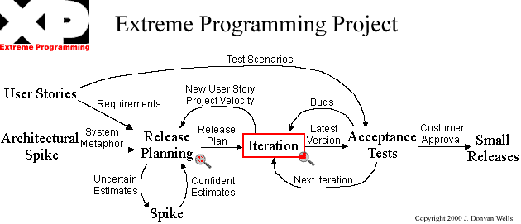
XP Project Model

Slide 8
Prototyping not always useful!
Requirement specifications & legal contracts are relevant!
Need to control ”loose cannon” developers: gold platers
Software design gone bad is very expensive
Hardware design is very, very expensive
Protyping is relevant in all types of project – but most often BEFORE requirement specifications are finalized

Slide 9
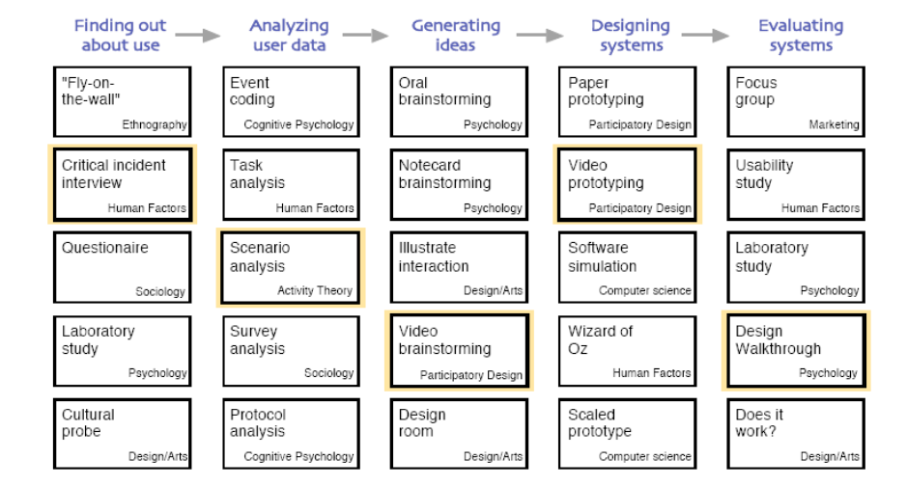
Methods, methods, methods

Slide 10
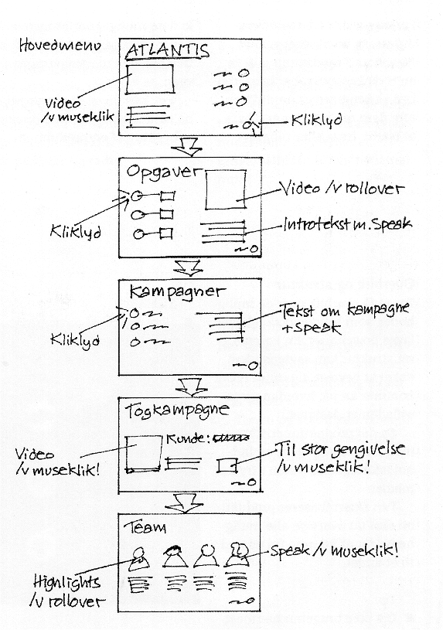
Techniques for prototyping
Mock-ups and Sketches
  Prototypes with low fidelity (lo-fi)
  Need not be computer-based – paper mock-ups
Storyboards
  Illustrates the flow through the system
  Can be paper, animated, or “live storyboards”
Scenarios
  Critical elements of a UI that needs testing
  Wizard of Oz technique
  Video prototypes
Horisontal / Vertical Prototypes
  Depending on what needs to be tested
  RAD tools are common for these
  Throw-away, incremental, evolutionary

Slide 11
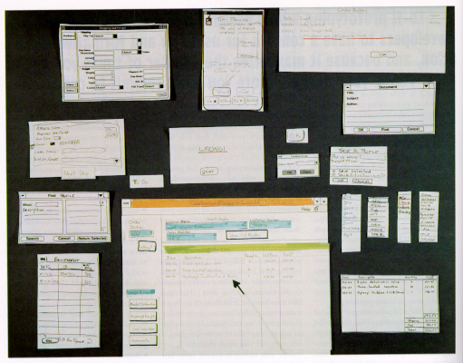
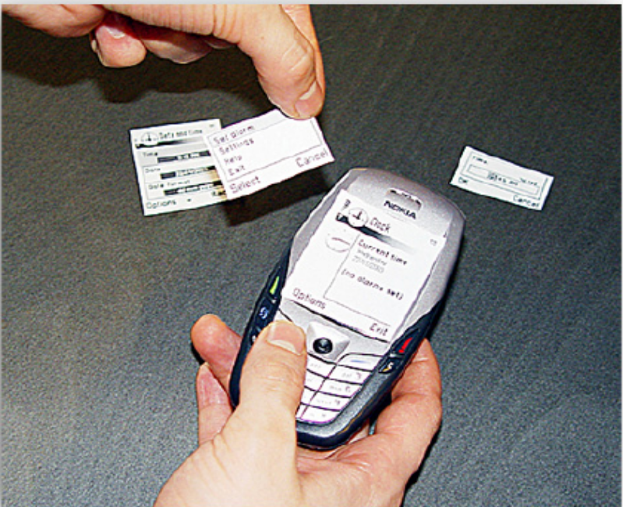
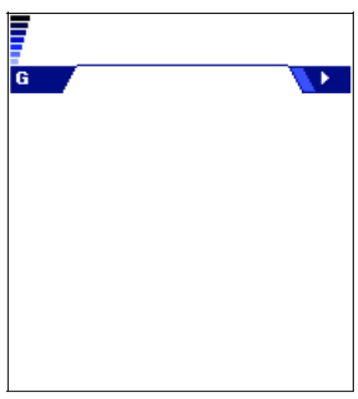
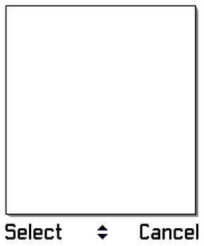
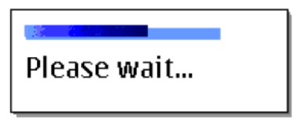
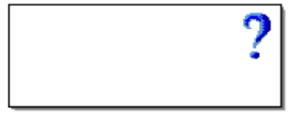
Nokia Uses
Paper Prototyping
Extensively

Slide 12
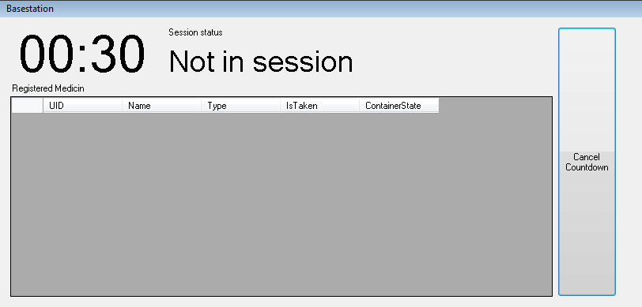
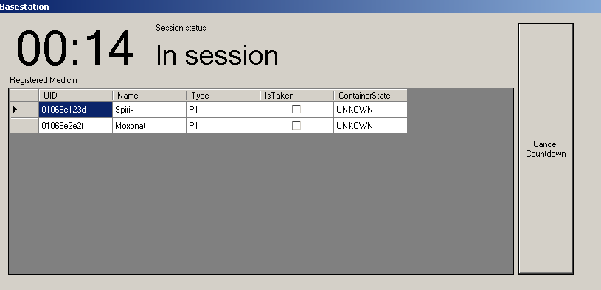
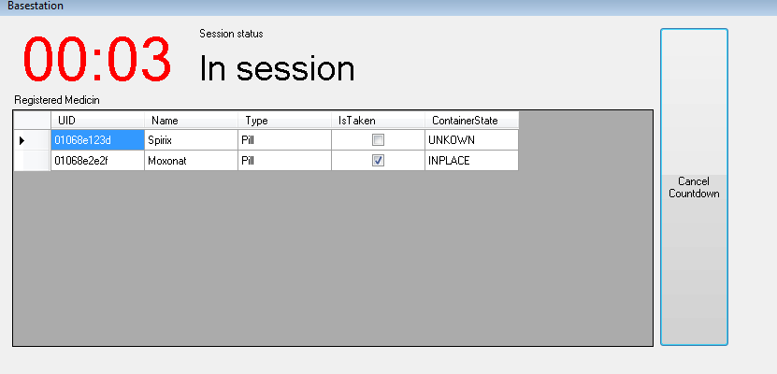
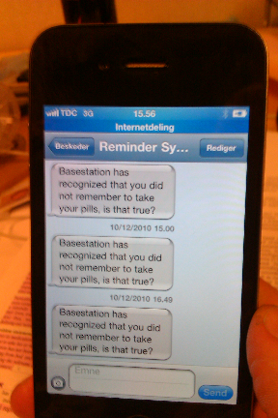
Director or Visual Studio?
Prototyping tools
  Director, Hypercard, PowerPoint, Frontpage
  prototyping tools produce slow programs
  Use HTML, images, sketches
  May evolve to a certain degree – then throw away
IDE tools with UI Builders
  Visual Studio, Delphi
  Uses the standard Widgets available
  May eventually evolve to full product
  May take a longer time to get started with
  Better for developers – not good for designers

Slide 13
Longitudinal prototyping

Slide 14
Longitudinal prototyping
Traditional prototyping often within confined timespan
Sometimes more feasible to test concepts over time
Wizard of oz and video prototypes not feasible
Higher demands:
  Must be easy to install and activate
  Must be sufficiently easy to use
  Must be sufficiently robust
  Must be able to store or forward test data
  Must have sufficient power supply

Slide 15
Prototyping in hardware

Slide 16
Prototyping in hardware
Wizard of oz and video prototyping:
  Simulates hardware functionality
  Good for initial evaluation of concepts
  Not good for evaluating feasibility of HW sensors
  Cannot be used in longitudinal prototype evaluation
Building “real” hardware prototypes is expensive
Use hardware prototype toolkits instead

Slide 17
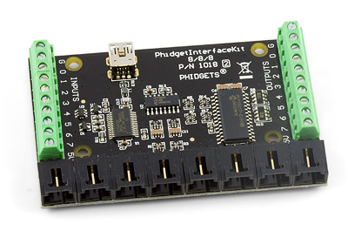
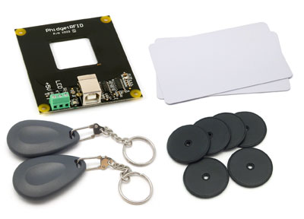
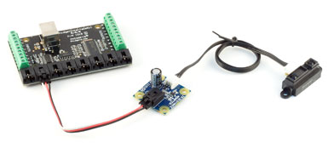
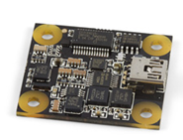
Prototyping hardware toolkits
Phidgets
Sun SPOT
Ardunio
Netdunio
FEZ
Intel Shimmer
More …

Slide 18
Case Study: UbiComp
Main research approach used in early ubiquitous computing projects:
“the construction of working prototypes of the necessary infrastructure in sufficient quality to debug the viability of the system in daily use; ourselves and a few colleagues serving as guinea pigs” [Weiser]
Used today in pervasive computing research

Slide 19
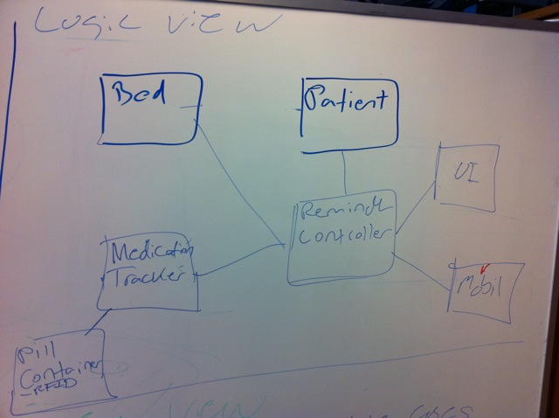
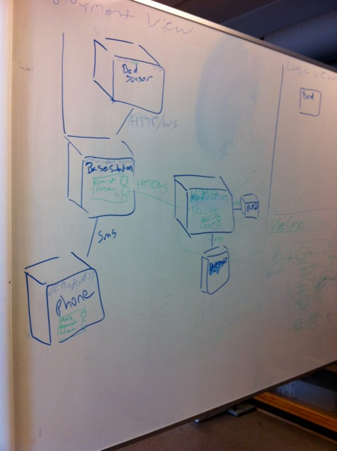
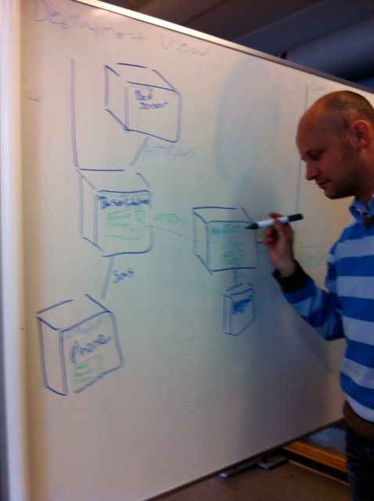
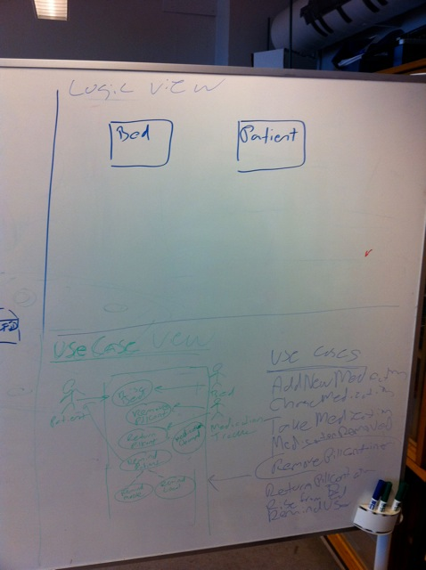
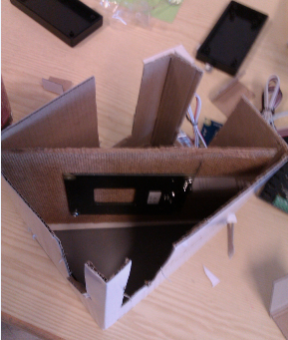

Slide 20
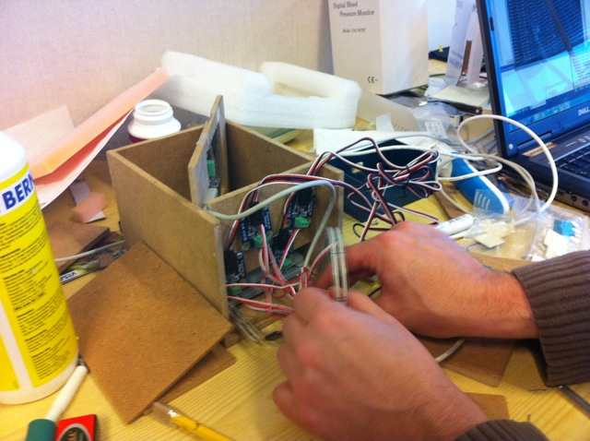
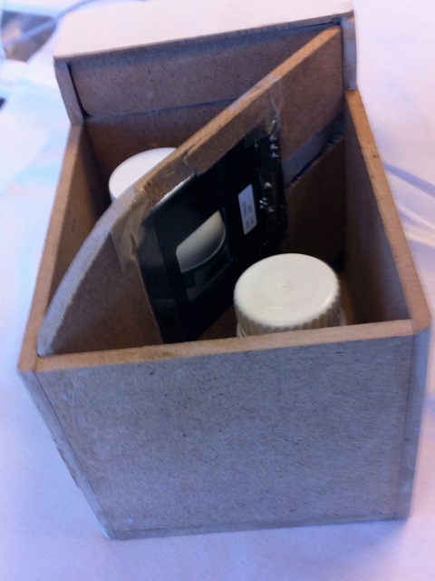
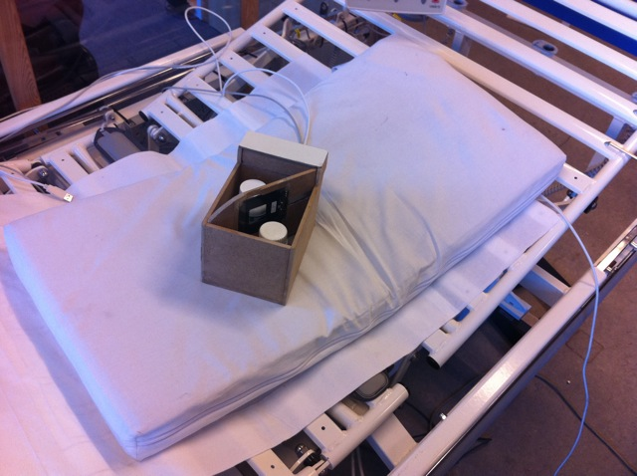

Slide 21
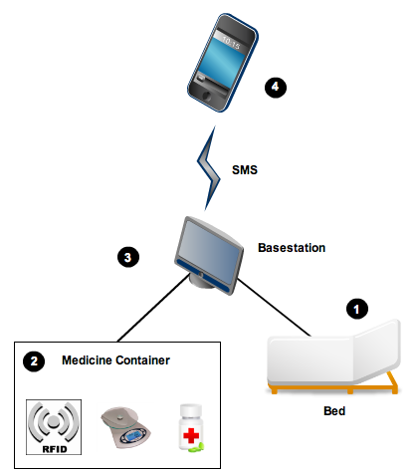
Protoype tools used
2x Phidgets InterfaceKit
RFID LF sensor
FlexiForce strain gauges
Visual Studio 2010
.NET 4.0 / C#
SMS Gateway

Slide 22
User Interface Prototypes Constructed

Slide 23
Like prototyping in hardware?
Take the course Applied Pervasive Computing
STTAPC1

Slide 24
Mini Project
Create Scenarios
Create Personas
Create Storyboard
Create 1st Lo-fi Prototype
Create 2nd Lo-fi Prototype

